Slide 1

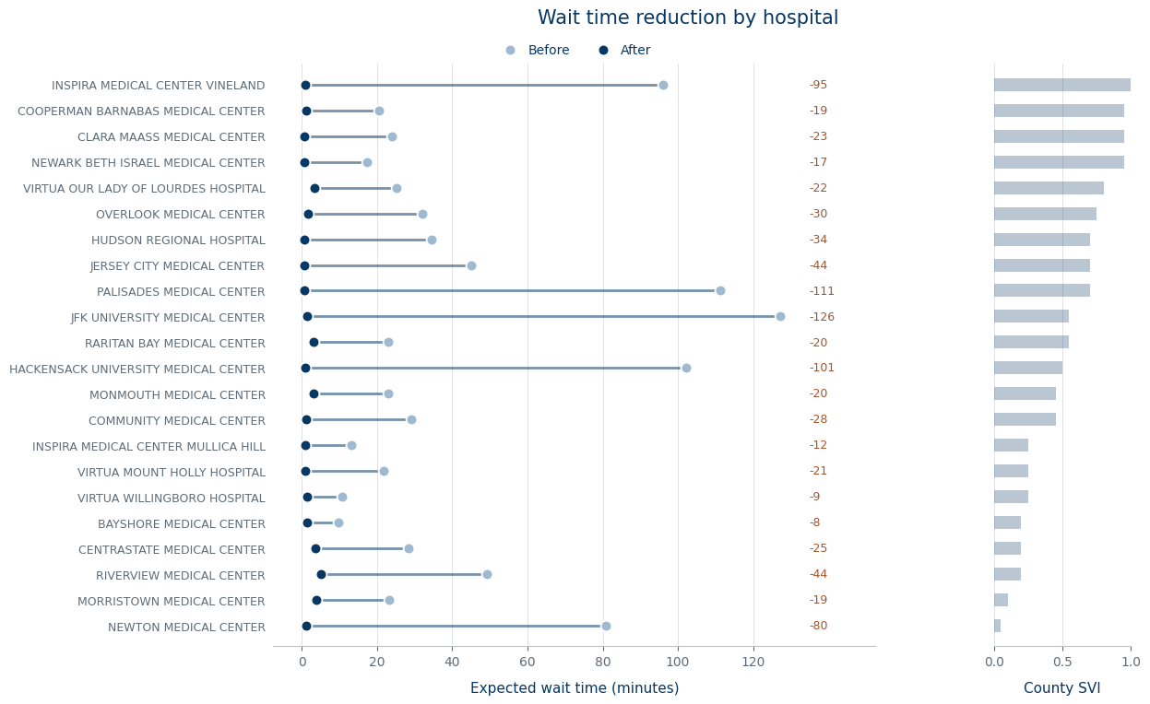
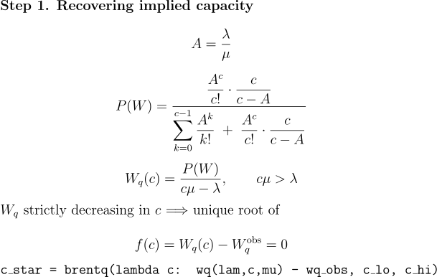
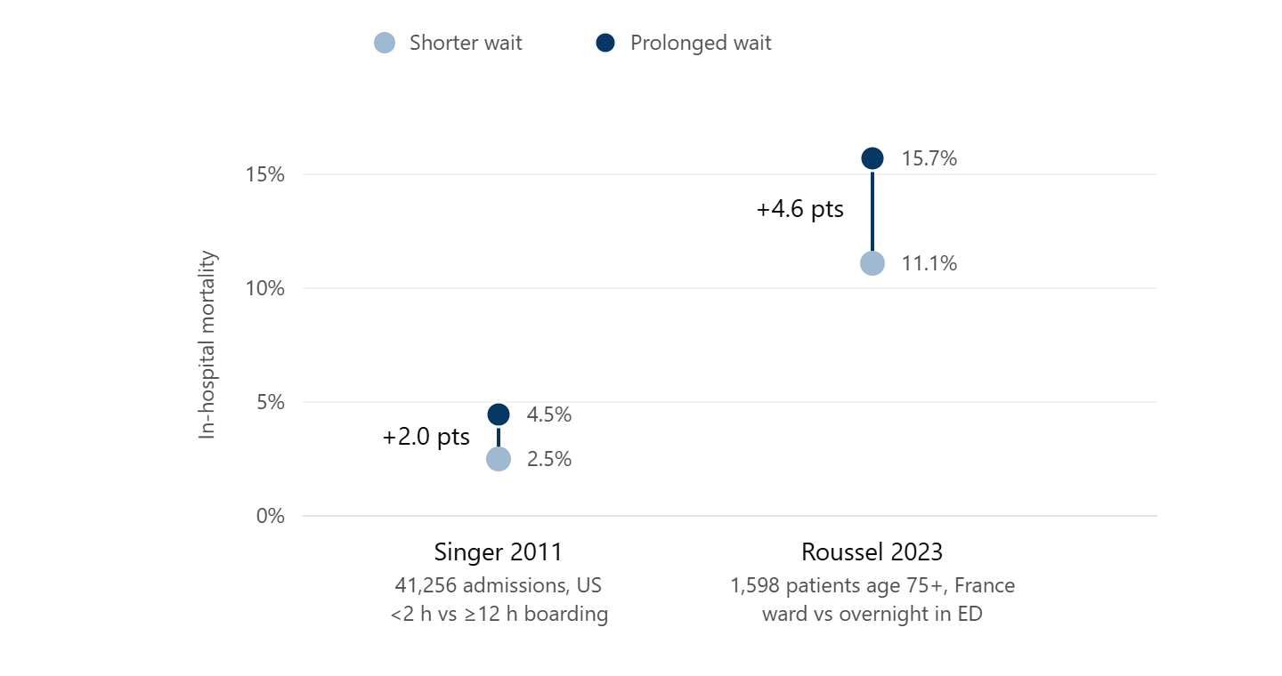
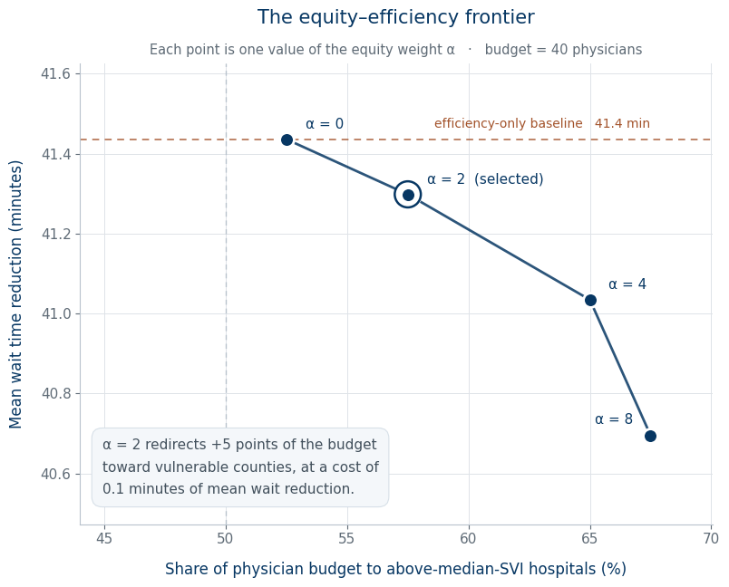
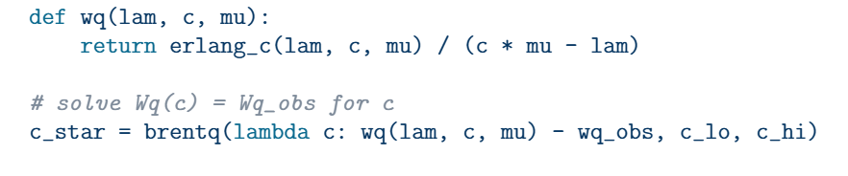
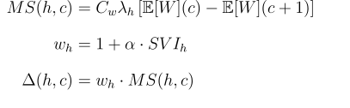
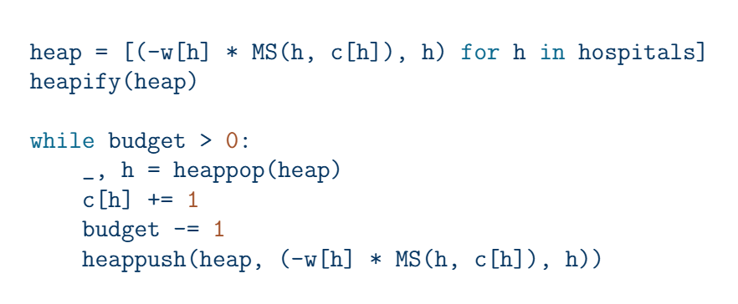
Solving for Optimal Staffing: An Inverse Queuing Approach to Equity-Weighted Physician Allocation Across New Jersey EDs
¹Rithvik Sharma ²Professor Padhu Seshaiyer
¹Academy of Mathematics, Science, & Engineering ²George Mason University
Abstract
Data Sources
Numerical Results & Conclusions
New Jersey emergency departments face persistent problems with patient wait times, jeopardizing both patient health and operational efficiency. Many existing allocation models aim to reduce wait times; however, most assume that all hospitals are equally deserving, so they allocate more physicians to medical centers with greater resources, as those resources yield higher returns on allocation. We model each ED as an M/M/c queue and use root-finding (brentq) to back calculate each hospital's implied physician capacity from observed CMS wait times, with arrival rates estimated via a bed share allocation of county level ED visit volumes (NJSHAD) to individual facilities (HCRIS). We then formulate an equity weighted greedy allocation algorithm for optimal physician allocation across hospital networks, but we incorporate an equity weight for CDC Social Vulnerability Index scores within the objective function. Applying this methodology, we achieved an average wait time reduction of 41.30 minutes across 22 NJ hospitals, enabling a more equitable and effective distribution of physicians across the whole state.
Mathematical Analysis and Simulation
Implied Staffing Model:
Greedy Algorithm Implementation:
Marginal Savings Function
Equity Factor Formula
Introduction
Mean reduction: 41.30 minutes.
Expected ED wait time before and after equity-weighted allocation, for 22 New Jersey hospitals ordered by county Social Vulnerability Index (high to low). Assumes μ = 2.55 patients/hr per physician, C_w = $120 per patient-hour of waiting, α = 2, and a budget of B = 40 additional physicians.
Bibliography/References
The Gap: Existing allocation models treat every hospital as identical, ignoring the socioeconomic conditions of the communities each serves. Because marginal returns on an added physician are highest at well resourced facilities, capacity concentrates there while hospitals in higher vulnerability counties fall further behind.
Singer AJ, Thode HC Jr, Viccellio P, Pines JM. The association between length of emergency department boarding and mortality. Acad Emerg Med. 2011;18(12):1324-1329.
Roussel M, Teissandier D, Yordanov Y, et al. Overnight stay in the emergency department and mortality in older patients. JAMA Intern Med. 2023;183(12):1378-1385.
Augustine JJ. More advanced practice providers working in emergency departments. ACEP Now. 2017;36(9).
Joseph JW, Davis S, Wilker EH, et al. Modelling attending physician productivity in the emergency department: a multicentre study. Emerg Med J. 2018;35(5):317-322.
Notes:
Singer AJ, Thode HC Jr, Viccellio P, Pines JM. The association between length of emergency department boarding and mortality. Acad Emerg Med. 2011;18(12):1324–1329 — pubmed.ncbi.nlm.nih.gov/22168198
Roussel M, Teissandier D, Yordanov Y, et al. Overnight stay in the emergency department and mortality in older patients. JAMA Intern Med. 2023;183(12):1378–1385 — jamanetwork.com/journals/jamainternalmedicine/fullarticle/2811179

